Slide 1
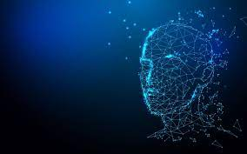
Facial Emotion Recognition Using Machine Learning

Slide 2







Team Members and their roles:
Chetana Nannapaneni
Mahesh Manchala
Data Scientist
Machine Learning Engineer
Pavan Teja Sripati
Shaik Adil
Computer Vision Specialist
Data Engineer

Slide 3
Contents:
The Problem
The Solution
Data Processing and Analysis Pipeline
Data Required
ETL Tools
CRISP-DM methodology
Business Understanding
Data Understanding
Data Preparation
Modelling
Evaluation and Results
Deployment and Prediction Example
Technology/expertise
Why we are better?
Market size
Measuring Success

Slide 4



The Problem
Problem #1
Making a Better Emotion Detector
Create a computer system that can look at a person's face and tell how they are feeling, like if they are happy, sad, angry, or something else. We want to make this system more accurate and faster.
Problem #3 Detecting Emotions in Difficult Situations
Make a system that can still tell emotions from faces even when the lighting is not good, the pictures are not very clear, or there is a lot of noise. This could be used for things like security cameras or other places where it's hard to see well.
Problem #2 Emotion Detector for Special Purposes
Build a computer system that can recognize emotions on people's faces for specific uses. For example, we could make it to help doctors see how patients feel during video calls or to help teachers understand how students are feeling in online classes.
01
02
03

Slide 5
The Solution
Solution #1
Solution #2
Solution #3
Improve accuracy and speed by using advanced algorithms and training the system with more facial expressions.
Customize the system for specific uses like healthcare or education by teaching it to understand relevant emotions.
Design the system to work in challenging conditions by making adaptable to poor lighting, unclear images, noisy environments
01
02
03

Slide 6
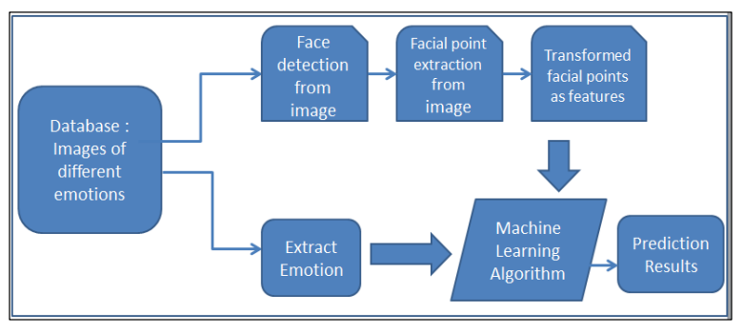
Data Processing and Analysis Pipeline:

Slide 7
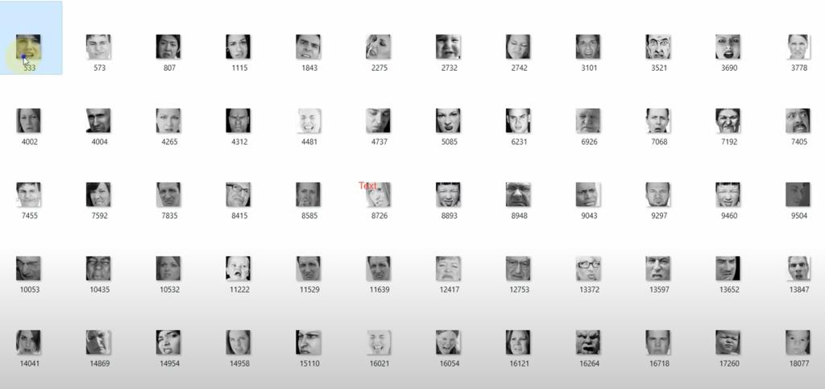







Data Required:
Image Data: High-resolution image data of individuals' faces in various environments, including low-light conditions, noisy settings, and with image quality variations.
Emotion Labels: Accurate emotion labels corresponding to each image, indicating the individual's emotional state.
Anger
Happy
Disgust
Fear
Neutral
Sad
Surprise

Slide 8









ETL Tools:
Data sources
Data Transformation and Preprocessing
Model Development
Data Storage
GUI’s

Slide 9
CRISP-DM methodology:
Business Understand-ing
Data Collection and Understand-ing
Deployment and Compliance
Data Preprocessing and Feature Extraction
Our Plan
Evaluation of Results
Data Split
Training the Model
Machine Learning Model

Slide 10
Business Understanding:
Business Objective: Enhance Patient Care and Well-being
Situation: In a hospital environment, patients with varying medical conditions receive care from healthcare professionals. Effective communication and patient comfort are critical for the healing process.
Data Science Goal: Develop a facial emotion recognition system that assists healthcare providers in understanding patients' emotional states. This system aims to improve patient care by helping medical staff adapt their approach based on patient emotions, ultimately enhancing patient comfort and well-being.

Slide 11
Data Understanding:
Data Sources:
The primary sources of data for this project are Kaggle and Dlib. Kaggle provides publicly available facial image datasets, while Dlib offers pre-trained models and libraries for facial feature extraction and facial emotion recognition.
Data Volume:
Kaggle datasets contain a substantial volume of facial images, often with thousands of samples available for analysis. Dlib provides pre-trained models for facial feature extraction, reducing the need for extensive labeled data.
Data Diversity:
Kaggle datasets are diverse, covering a range of age groups, genders, ethnicities, and emotional expressions, making them representative of a broad user group. Dlib's pre-trained models are versatile and can work with diverse facial data.
Data Labeling:
Kaggle datasets are typically labeled by human annotators, ensuring accurate emotion annotations. Dlib's models can be used for facial feature extraction, reducing the need for extensive manual labeling.
Data Privacy:
Privacy considerations are essential when using Kaggle datasets, and it is crucial to respect the privacy rights of individuals whose images are included. Consent and ethical data usage are of utmost importance.
Data Exploration:
Initial data exploration may include visualizations and statistical analysis of Kaggle datasets to gain insights into the distribution of emotions and image quality.
Data Imbalances:
Assess whether there are imbalances in the distribution of emotions within the Kaggle datasets, as this can impact model training and evaluation.

Slide 12
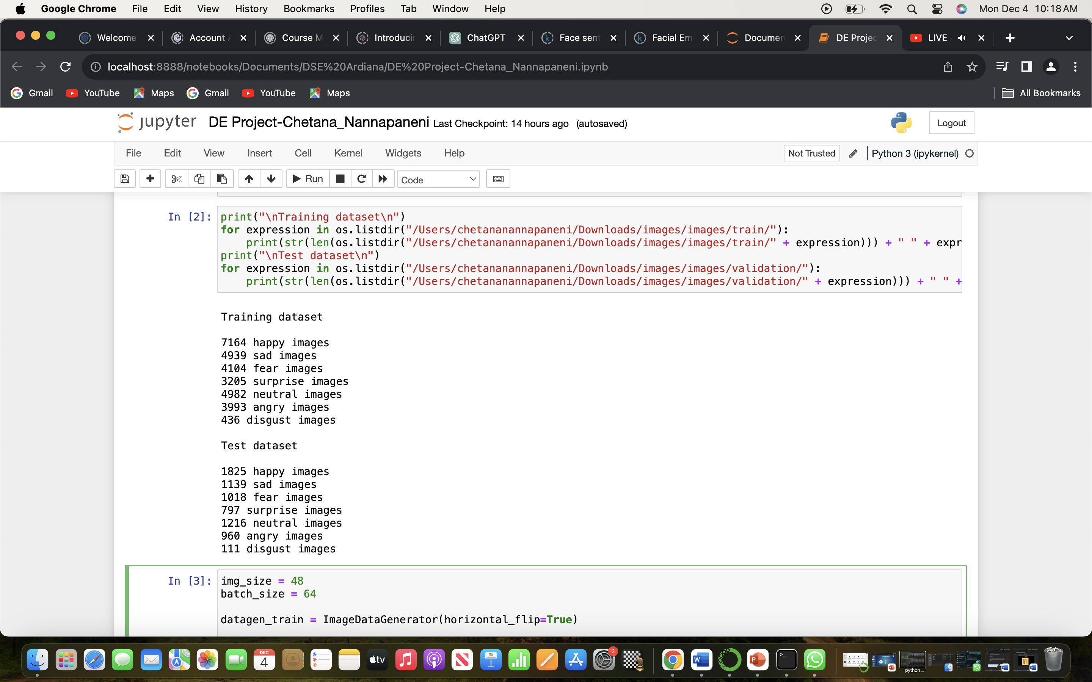
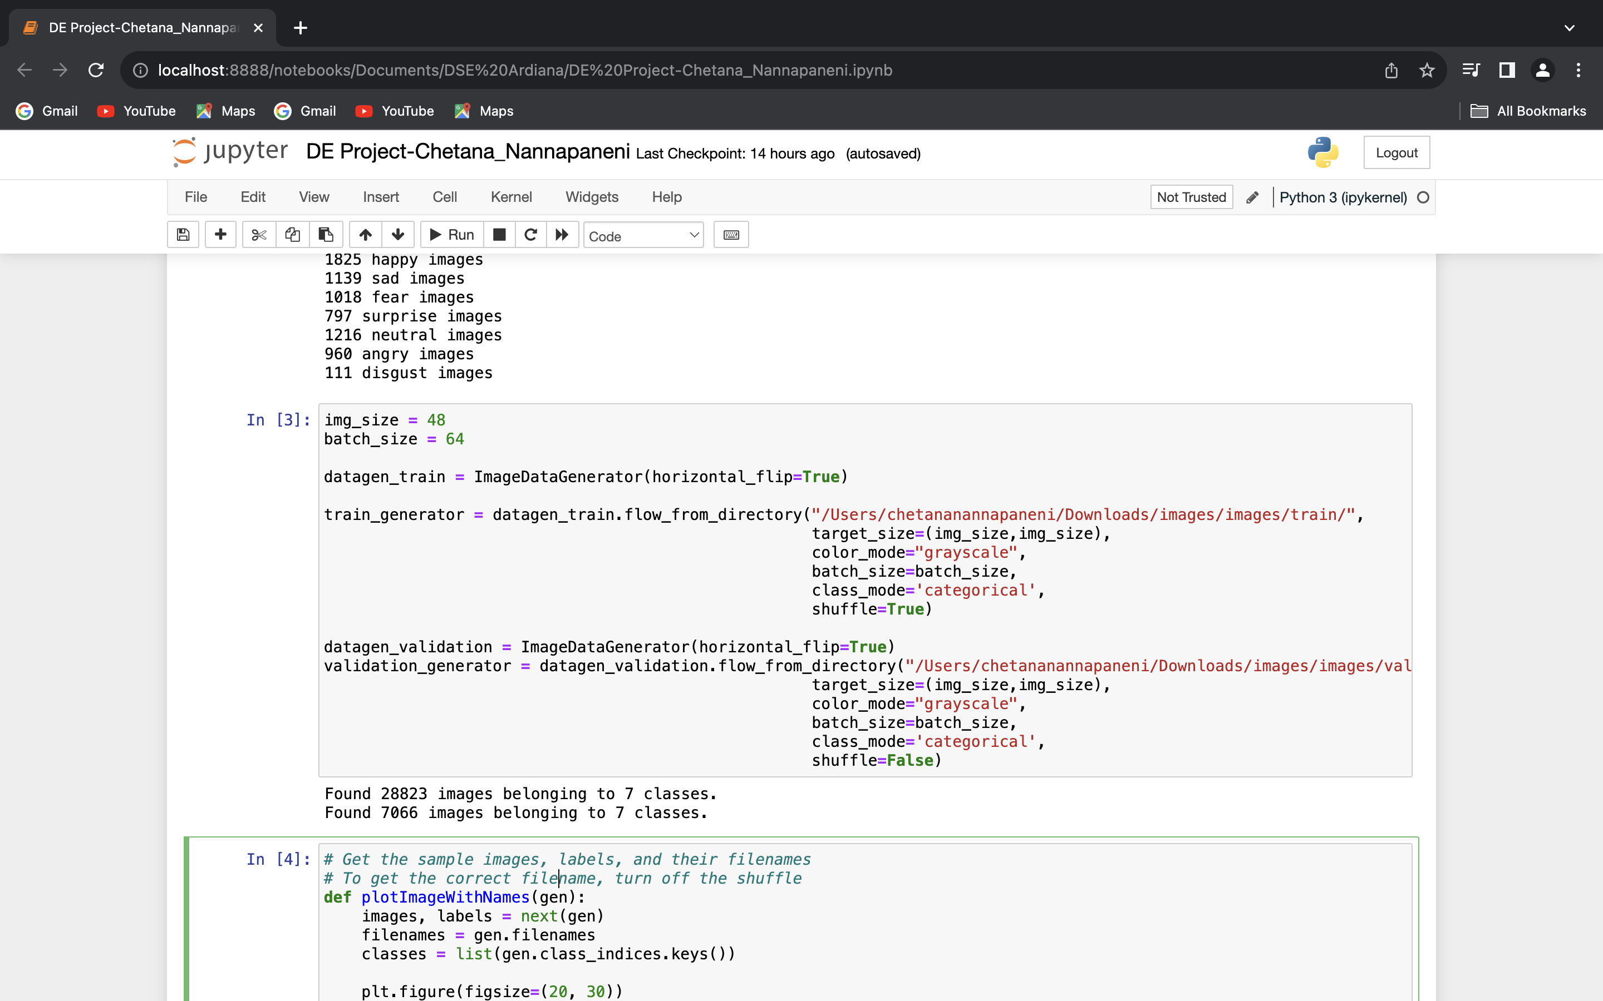
Data Preparation:
Here the code displays the information about my training and test datasets. Specifically, it prints the number of images for each emotion class in both the training and validation sets. The generator will automatically generate augmented images during training, helping the model generalize better to unseen data.

Slide 13
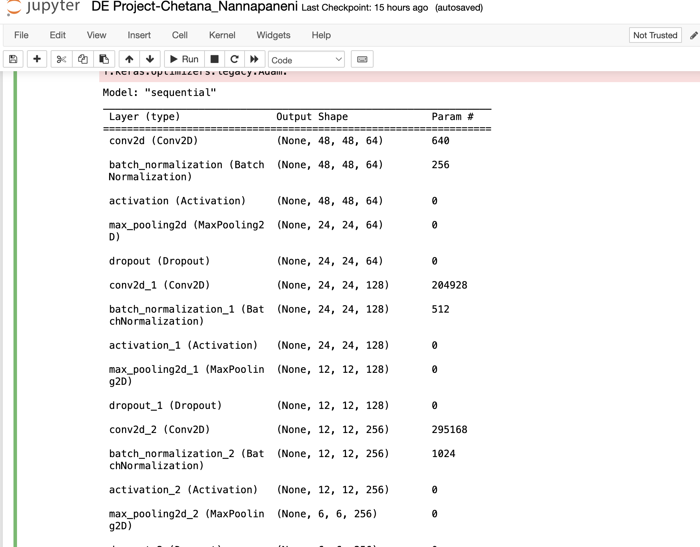
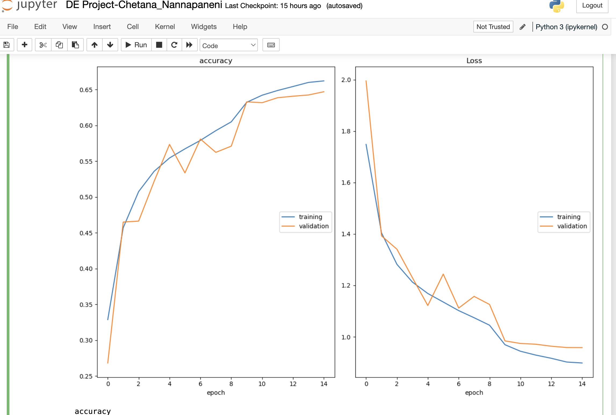
Modelling:
Model Architecture:
Model Training:

Slide 14
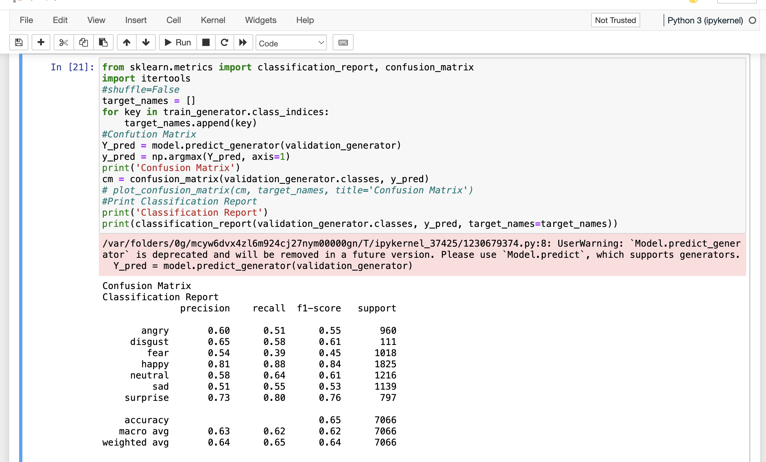
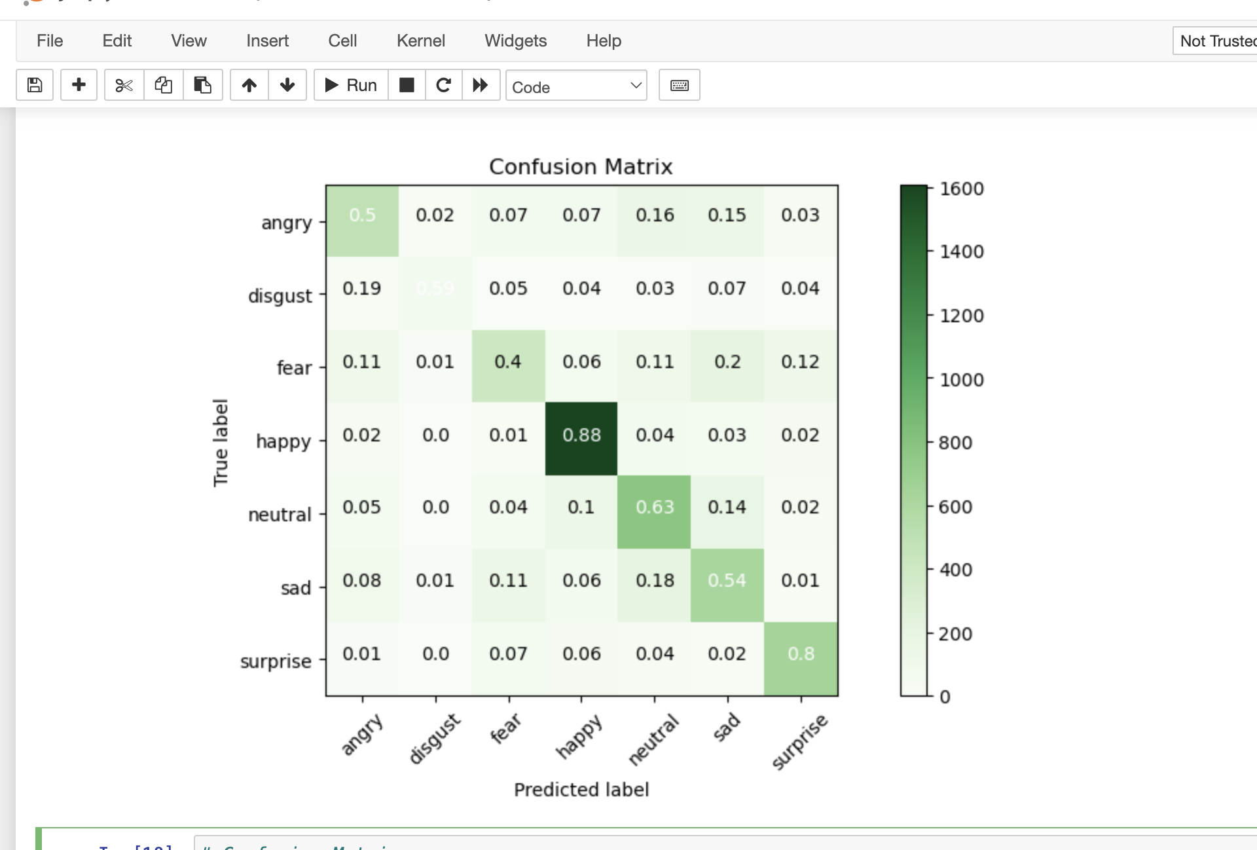
Evaluation and Results:

Slide 15


Slide 16
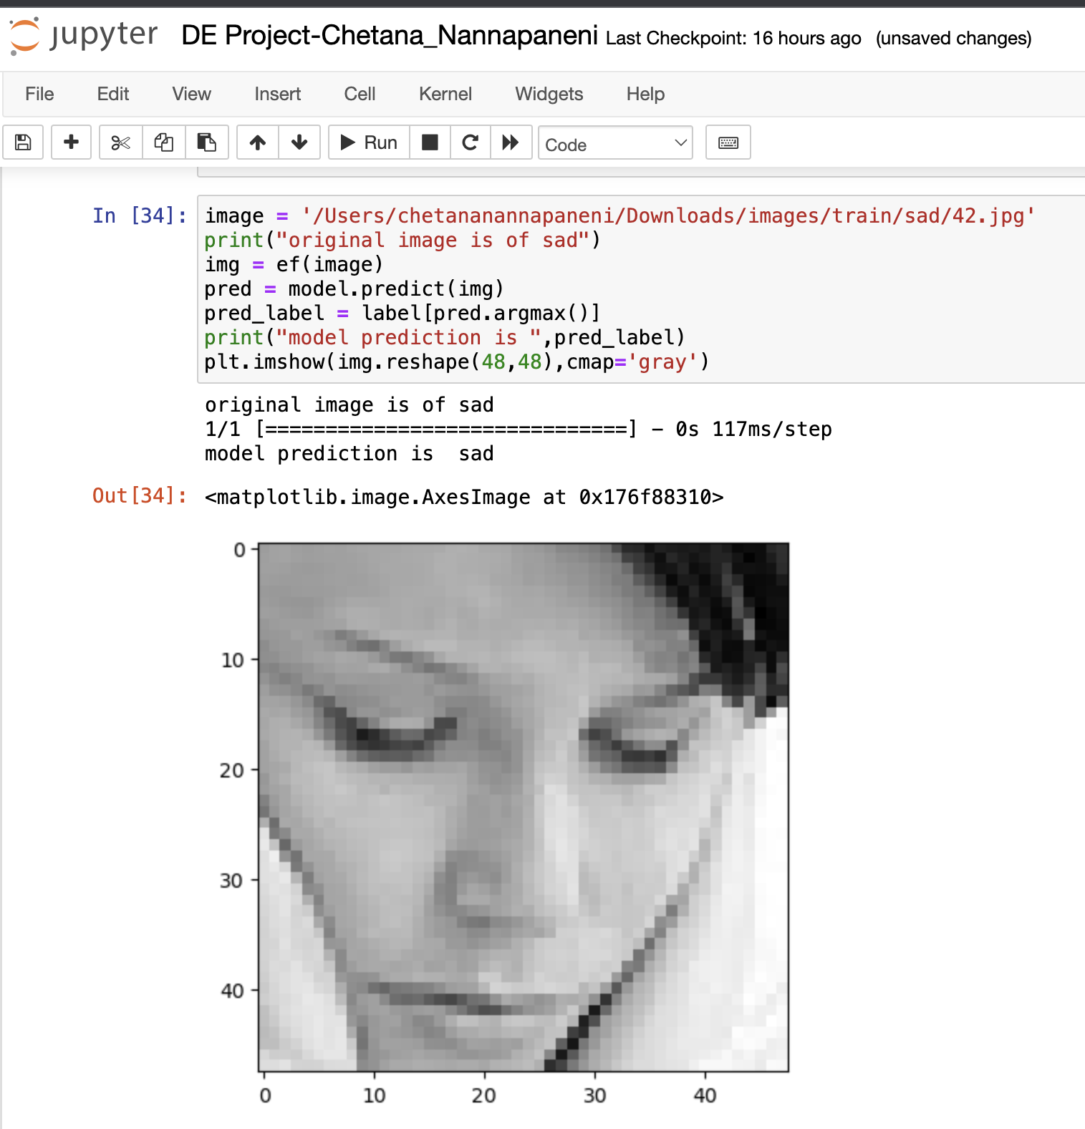
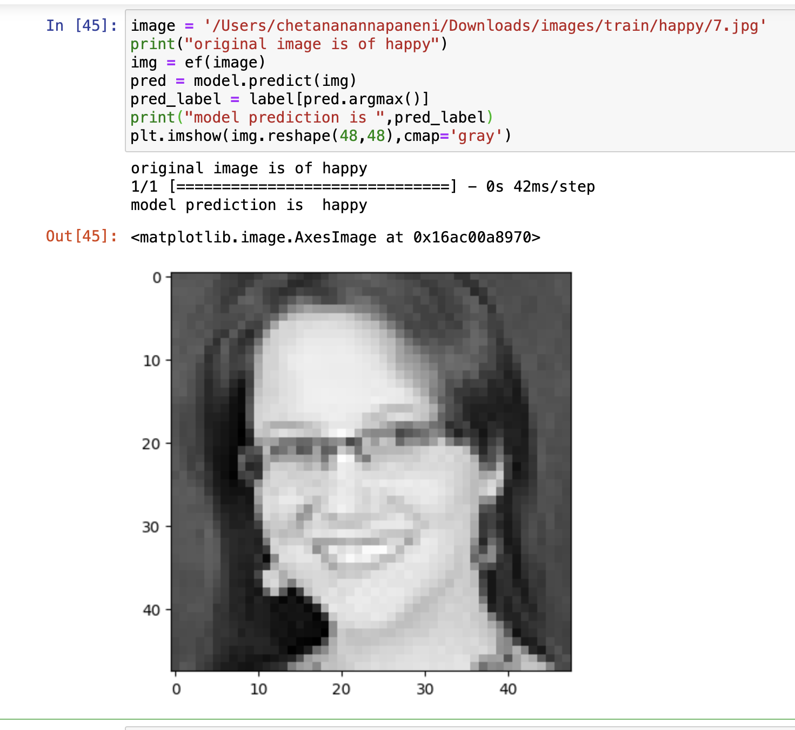
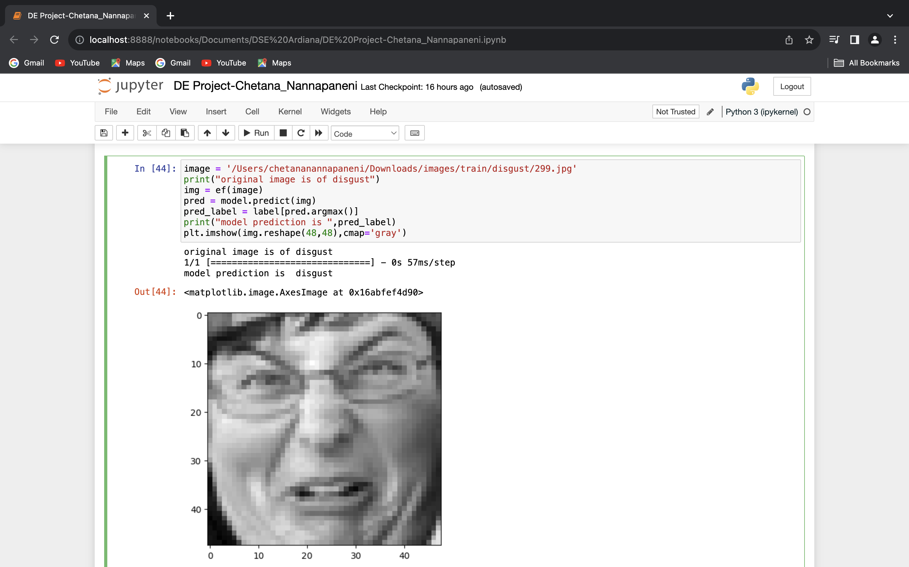
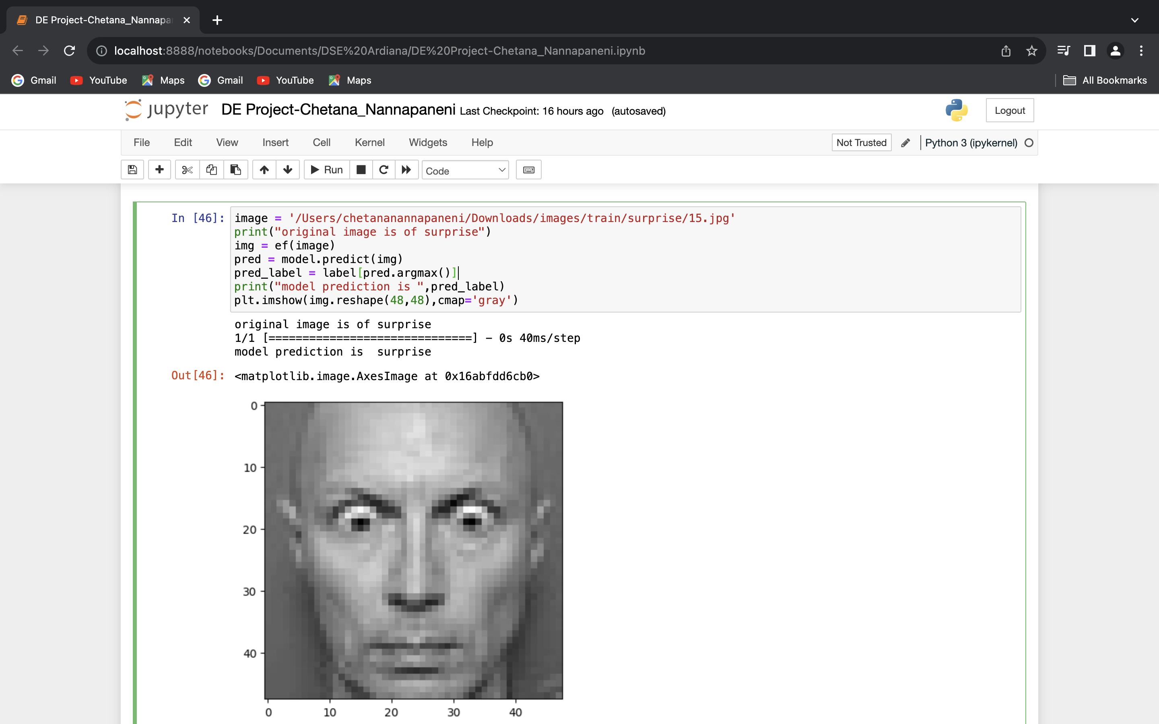
Deployment and Prediction Example:

Slide 17

Technology/expertise
Machine Learning Algorithms use of ML algorithms like CNNs for emotion classification.
Data Processing Skills Emphasize the ability to collect and preprocess diverse facial expression data.
Model Customization expertise in fine-tuning the system for specific applications

Slide 18
Why We are Better?
Advanced Machine Learning Algorithms
Diverse Training Data
Accurate Emotion Recognition
Our system employs state-of-the-art ML algorithms and has been trained on a diverse dataset of facial expressions, resulting in highly accurate emotion detection.

Slide 19
Market Size
2023
22M
Emo Tech Pro: Transforming Emotion Analytics
In 2022, the market exceeded $22 billion, propelled by the rapid adoption of emotion recognition in telehealth, virtual learning, and enhanced customer experiences in industries like gaming and e-commerce.
10M
2022
3.5M
Emo Sense Max: Revolutionizing Emotional Intelligence
Back in 2021, the global Facial Emotion Recognition market reached $10 billion, marking the beginning of a widespread interest in this technology with applications in security and marketing research.
2021
Emo Track 360: Unleash the Power of Emotion Detection
These snippets offer a glimpse of the technology's growth, market size, and key titles across different years, providing a historical context for its development and adoption.

Slide 20

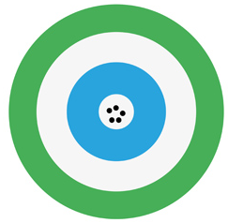


Measuring Success
How will we define & measure success?
Accuracy and Precision Regularly evaluate the system's accuracy and precision in emotion detection by analyzing its performance on real-world data. Ensure high levels of correct emotion identification.
User Satisfaction Measure user satisfaction and feedback to gauge the system's impact on user experience. Positive feedback, improved engagement, and user comfort are indicators of success.
Market Share and Adoption Track the system's market share and its adoption in various industries. A growing presence in healthcare, education, security, and entertainment sectors demonstrates its success and relevance.

Slide 21

Thank You!

Slide 22
Links:
Github: https://github.com/Chetana1025/DE-Team2-Project
Pitch Deck Video: https://youtu.be/Gfoe7XZEXqM

